Slide 1
FinTech Disruption in Financial Industry
Introduction to FinTech
Prof. Xiaoyu (Joanna Wang)
Peking University

Slide 2
Readings
'Even if a Thousand Projects Don’t Make It, Blockchain Is Still a Change Catalyst' Gensler, CoinDesk
‘Economics of Money & Blockchain Technology and Evaluating Projects’ MIT Cryptocurrency Online Course
‘Responses from Big Finance’ MIT Cryptocurrency Online Course
'The technology of retail central bank digital currency' Bank of International Settlement

Slide 3
Study Questions
How does Bitcoin fit within the history of money, the emergence of the Internet and failed attempts of cryptographic payment systems?
What are the strategic and tactical considerations in assessing the viability and value proposition of a blockchain technology project? How can you separate rigorous analysis from mere assertion and hype in the blockchain ecosystem?
What strategic considerations should go into Central Banks thinking of expanding access to digital reserves through central bank digital currency (CBDC)?

Slide 4
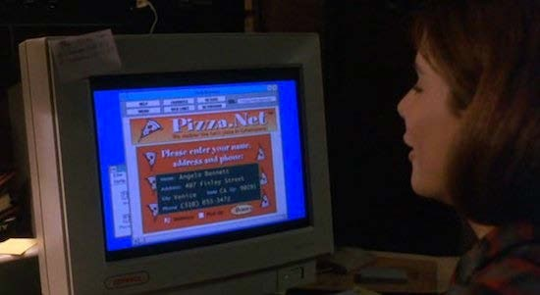
‘The Net’ opening scene, 1995
© Columbia Pictures. All rights reserved. This content is excluded from our Creative Commons license. For more information, see https://ocw.mit.edu/help/faq-fair-use/
Sandra Bullo₅ ck

Slide 5
Early Cryptographic Digital Currencies … Failed
Notable Efforts
DigiCash (1994), Mondex (1994), CyberCash (1994)
E-gold (1996), Hashcash (1997)
Bit Gold (1998), B-Money (1998), Lucre (1999)
Hurdles
Merchant adoption
Centralization
Double Spending
Consensus

Slide 6






Early Digital & Mobile Payment Solutions
Secure Socket Layer Transport Layer Security
Cryptographic Protocols for Secure Network Communication
SSL / TLS - 1996
1998
1999
2003
2007
© Various sources. All rights reserved. This content is excluded from our Creative Commons license. For more information, see https://ocw.mit.edu/help/faq-fair-use/
8

Slide 7
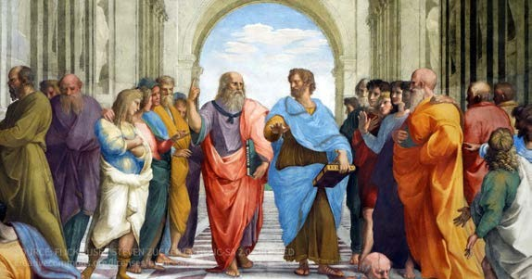
Money
Plato:
Money is a ‘symbol’ devised for the purpose of exchanges
Opposed using gold or silver for money
Aristotle:
Solves the ‘problem of commensurability’
Image is in the public domain.
‘Money is a guarantee that we may have what we want in the future. Though we need nothing at the moment it insures the possibility of satisfying a new desire when it arises.’
Four absolutes to have ‘Universal Value’:
Durable, Portable, Divisible & Intrinsic Value
Modern Characteristics:
Durable, Portable, Divisible, Uniform, Acceptable, & Stable

Slide 8
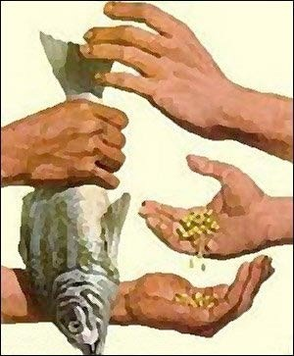


What is the Role of Money?
© Source Unknown. All rights reserved. This content is excluded from our Creative Commons license. For more | Image by Rob Pongsajapan on flickr. CC BY. | mage by ajalfaro on flickr. CC BY-NC-SA
information, see https://ocw.mit.edu/help/faq-fair-use/
Medium oooff Exchange | Store of Value | Unit of Account

Slide 9
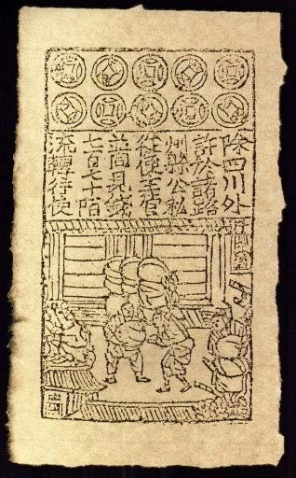

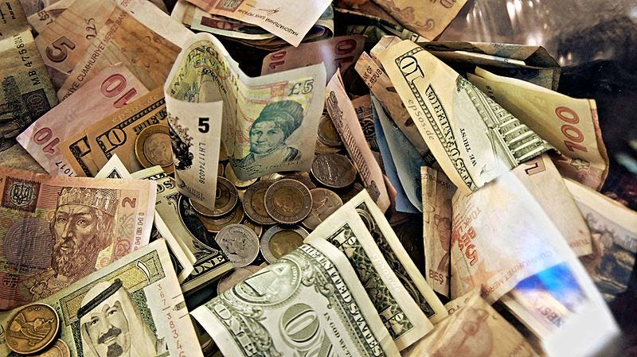
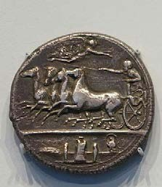
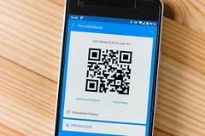
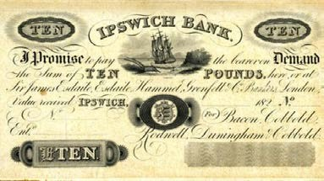
Money
Image by epSos.de on Wikimedia. CC BY
Image is in the public domain.
Image is in the public domain.
Cowrie Shells Nigeria
Jiaozi Promissory Note Song Dynasty China
Fiat Paper Money
Image by Daderot on Wikimedia. License: CC0.
Silver Dekadrachm Greece
Image is in the public domain.
Image by markus 119 on Flickr. CC BY
Private Bank Notes United States
Alipay Mobile Wallet China
11

Slide 10
Fiat Currency
Represented by:
Central Bank Notes
Central Bank Reserves &
Commercial Bank Deposits
Relies upon System of Ledgers
Very Significant Network Effects:
Image by epSos.de on Wikimedia. CC BY
Accepted for Taxes
Legal Tender for All Debts Public & Private
Accepted throughout Economy / Optimum Currency Area
12

Slide 11
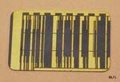

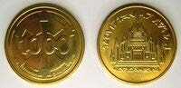
Money’s Future?
© DK. (Publishing) All rights reserved. This content is excluded from our Creative Commons license. For more information, see https://ocw.mit.edu/help/faq-fair-use/
© Hasbro. All rights reserved. This content is excluded from our Creative Commons license. For more information, see https://ocw.mit.edu/help/faq-fair-use/
Credit Chip Galactic Republic
Wupiupi Hutts on Tatooine
Imperial Credit Coin The Empire
13
Source: Wookieepedia, The Star Wars Wiki

Slide 12
Satoshi Nakamoto: Bitcoin P2P e-cash paper October 31, 2008
“I've been working on a new electronic cash system that's fully peer-to-peer, with no trusted third party.”
14

Slide 13


Blockchain Technology
timestamped append-only ledger
multiple party consensus protocol
decentralized auditable database
Addresses ‘cost of trust’ (Byzantine Generals problem) May use Native Token as incentive
Secured via cryptography
Tamper resistant record of
Hash functions for integrity
Digital signatures for consent
Transfers of value
Running of computer co₁d₅ e
Permissioned
Permissionless

Slide 14
Smart Contracts
“A set of promises,
specified in digital form,
including protocols
within which the parties perform on these promises.” Nick Szabo, 1996
However ….
Smart Contracts may not be ‘Smart’
Smart Contracts may not be ‘Contracts’
16

Slide 15
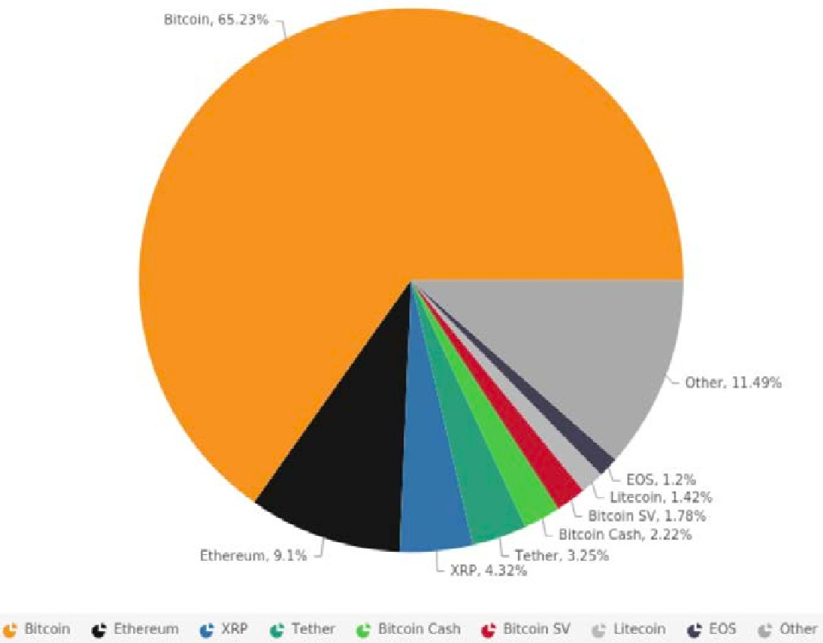
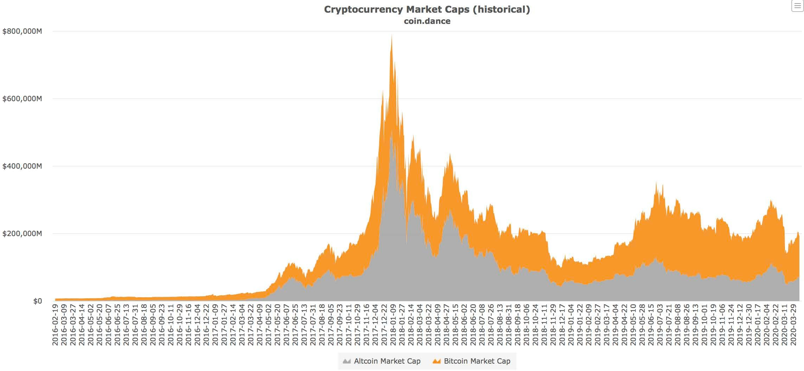
Crypto Market - $199 Billion (4/12/20)
17
Courtesy of Coin Dance. Used with permission.

Slide 16

Crypto Token Sectors
Payment / Store of Value Tokens
Bitcoin ($128B), …
$152B – 76%
Platform Tokens $29B – 15%
Ethereum ($18B), …
DApp Tokens $10B – 5%
Binance Coin ($2.3B), …
Stable Value Tokens $8B – 4%
Tether ($6.4B), …
Tokenized Securities and Assets
18
Source: Market Values from CoinMarketCap (4.12.20)

Slide 17
Blockchain Tech Potential Uses
Speculative Investing
Crowdfunding through Initial Coin Offerings
Tokens for Exchanges, Gaming, Gambling, DeFi & File Sharing
Tokenized Fiat (Stable Value Coins), Securities & Assets
Payment Systems
Trade Finance & Supply Chain Management
Clearing, Settlement & Processing
Central Bank Initiatives
Digital ID & MIT Diploma
Medical Records, Property Records, Internet of Things, Voting …
19

Slide 18
Blockchain Technology Challenges
Scalability, Performance & Efficiency
Privacy
Security
Interoperability
Governance
Public Policy Frameworks
Commercial Use Cases

Slide 19
Framework for Comparing Costs & Trade-offs
Coordination, governance,
security, scalability
Capture, Rents,
Single Point of
Failure
Decentralized
Centralized

Slide 20
Vitalik Buterin Trilemma
Decentralization
Scalability
Security

Slide 21
Assessing Use Cases – First Considerations
Which side of a divide the project is on?
Is the project one that services the new crypto asset class?
Is the project one uses blockchain technology and cryptocurrencies?
Projects servicing the cryptocurrency space:
Custody solution – Coinbase, Fidelity Software provider – Blockstream Hardware company – BitMain
Mining pool operator – BTC, F2Pool, Poolin
Exchange operation – Binance, Coinbase Wallet provider – Circle
Asset manager – Bitcoin Suisse, Galaxy News service – CoinDesk

Slide 22
Assessing Use Cases – Strategic Considerations
What value creation proposition is there?
Decentralized vs. Centralized Computing?
Native Token filling what Gaps in Fiat Currency system?
What are competitors (Traditional & Blockchain) doing?
Why use append only ledgers, multiple party consensus and native token?
What verification or networking costs can actually be reduced?

Slide 23
Assessing Use Cases – Tactical Considerations
Which data needs recording on append-only ledgers?
Which multiple stakeholders need ‘write’ access to the shared ledger?
What are the tradeoffs of performance, privacy, security, governance & regulation?
How can broad adoption and user interface be realized?
If permissionless, what are the token incentive systems?

Slide 24
Assessing Use Cases – Deeper dive
Why use multiple party shared ledger?
Why choose a distributed ledger solution over a centralized one?
Why not rely on a third-party authority or host?
Is the value proposition well distributed amongst all parties?
What is the adoption model?
What specific verification or networking costs can be reduced?
Authentication? Traceability? Trust?
Are the transaction processes & data standardized?
How much data needs to be stored?

Slide 25
Incumbents’ Choices of Databases
Access
Client Server Permissioned Permissionless
Traditional Databases
Trusted Party Hosts Data
Private Blockchain
Known Participants
Private Write Capability
Append Only Timestamped Log Publicly Verifiable
No Native Currency Needed
Public Blockchain
Unknown Participants
No Central Intermediaries Public Write Capability Peer to Peer Transactions Native Tokens & Incentives
Trusted Party can Create, Read, Update, & Delete (CRUD)
Client Server Architecture

Slide 26
Central Bank Initiatives
Real Time Gross Settlement
Brazil, Canada (Project Jasper), Europe and Japan (Project Stella), Singapore (Project Ubin), South Africa (Project Khokha)
Digital Currency
Central Bank Claim: Bahamas (Sand Dollar), Ecuador (Dinero Electrónico), Iran (Payman), Sweden (E-Krona)
Commercial Bank Claim: Philippines (ePiso), Senegal (eCFA), Tunisia (e-Dinar)
Possible Hybrid: China (Digital Currency Electronic Payment)
Commodity Backed: U.K. (Royal Mint Gold), Venezuela (Petro)
Other: Dubai – emCash, Saudi & UAE (cross-border pilot), Uruguay (Digital Peso)

Slide 27
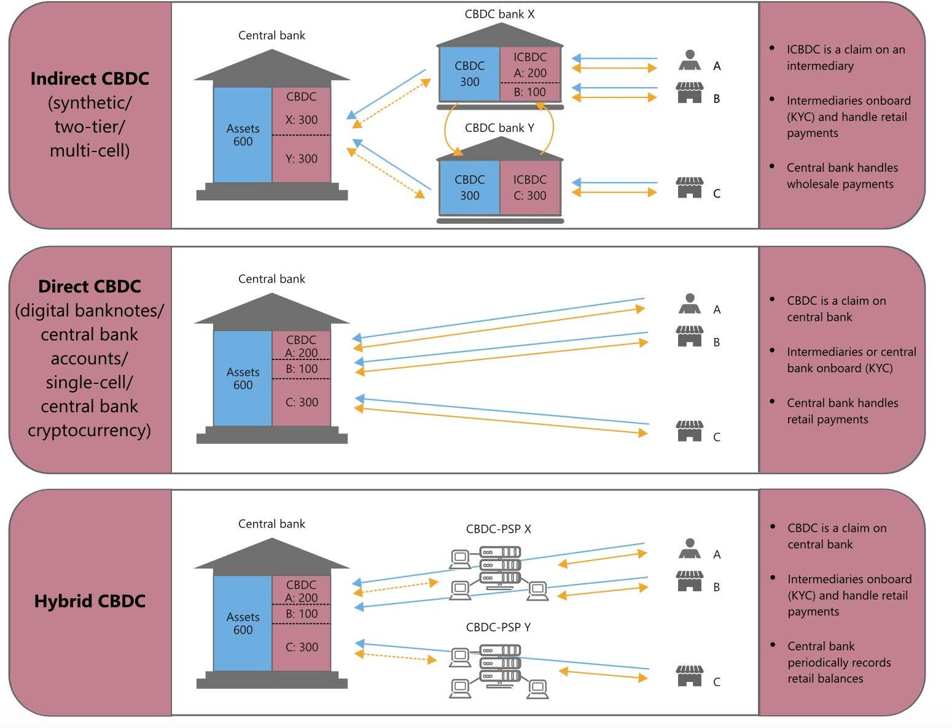
CBDC Potential Architectures
29
Source: 'The technology of retail central bank digital currency’, BIS (3/20)
© Bank of International Settlements. All rights reserved. This content is excluded from our Creative Commons license. For more information, see https://ocw.mit.edu/help/faq-fair-use/

Slide 28
CBDC – Opportunities
Continue Government Provision of a Means of Payment
Promote Competition in Banking System
Promote Financial Inclusion & P2P Payments
Address Payment System ‘Pain Points’
For Some Nations, Possibly Avert Sanctions

Slide 29
CBDC - Challenges & Uncertainties
Financial Stability and Potential to Increase Ease of Bank Runs
Changes to Commercial Banks’ Deposits and Funding Models
Effects on Credit Allocation and Economy
Monetary Policy Implementation & Transmission
Resilience of Open Payment Infrastructures

Slide 30
Ground Truths
Nakamoto solved the payments riddle - avoiding double spending
Money is but a social & economic construct
We already live in an age of digital money
Append-only logs & multiparty consensus provides a peer-2-peer alternative
Blockchain technology can address verification and networking costs
Adoption rests on addressing comparative viability & value proposition

Slide 31
Ground Truths
Crypto markets are rife with scams, fraud, hacks & manipulation
Cryptocurrencies have evolved into a speculative asset class
Crowdfunding built on smart contracts & ICOs raised nearly $30 billion
Lightly & non regulated markets provide retail investors direct way to trade
The potential, though, to be a catalyst for change is real

Slide 32
Readings
'The Digitalization of Payments and Currency: Some Issues for Consideration' Lael Brainard, Federal Reserve Board
‘The Payment Systems Space’ MIT Cryptocurrency Online Course
'7 Key Payments Innovations in Fintech for 2020' Codete
'9 Payment Trends That Will Shape 2020' Estelle Mense, BlueSnap
3

Slide 33
Study Questions
What are the challenges and opportunities in the current payment system architecture?
What lessons can be drawn from Big Tech payment innovations such as Alipay, WeChat Pay, M-Pesa, Paytm, Kakao Pay, Amazon Pay, Apple Pay, & Google Wallet? What lessons from fintech disrupters such as Plaid, Square, Stripe, Toast, TransferWise, Venmo, etc.? What are incumbents such as the major banks as well as Visa, Mastercard and PayPal responding to the changing landscape?
Do stable value coins and tokenized assets fill real gaps in payments and the financial markets? If so, will stable coins or tokenization take off or just be a passing fad?
4

Slide 34
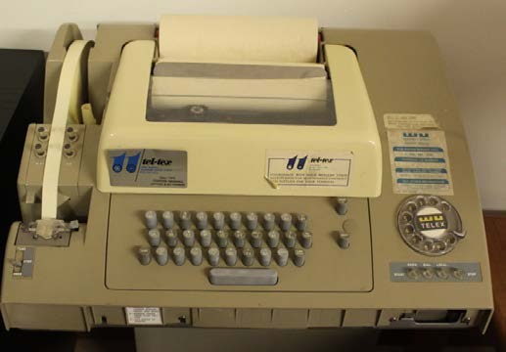
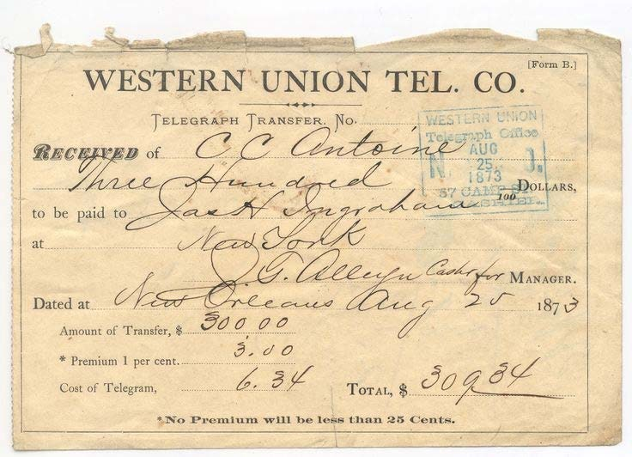
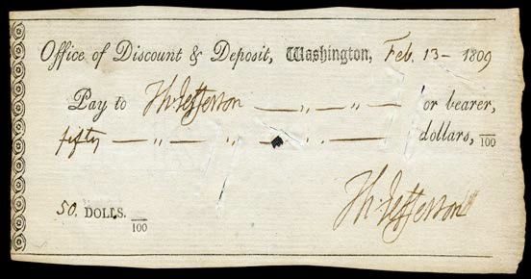
Payment Systems
A Method to Amend and Record Entries on Ledgers for Money Authorizing, Clearing and Recording Final Settlement
Personal Check Thomas Jefferson 1809
Western Union Telegram
1873
Telex 1950s – 1970s
Check and telegram are in the public domain. Telex image by ajmexico on flickr. CC BY.
5

Slide 35
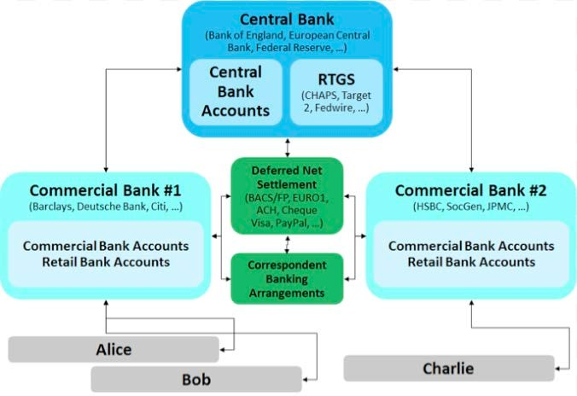
Payment Systems
Image by Richard Gendal Brown. Used with permission.
6
Source: ‘A Central Bank “Cryptocurrency”? An interesting Idea, but maybe not for the reason we think’, Richard Gendal Brown, (3/5/15)

Slide 36





Modern Payment Systems
Alipay Amazon Pay Android Pay Apple Pay
GoPay Kakao Pay M Pesa PayPal
Paytm Samsung Pay Venmo WeChat Pay
Access method
Consumer 2
Digital wallets:
Consumer 1
Payment Instrument
Checks Credit Card Debit Card Prepaid Card
Payment Instruction Others
Networks & PSPs
Merchant Bank
Issuing Bank
First Data/Stripe/etc.
ACH
Other
Merchant
Acquirer
Cryptocurrency (Bitcoin)
7

Slide 37
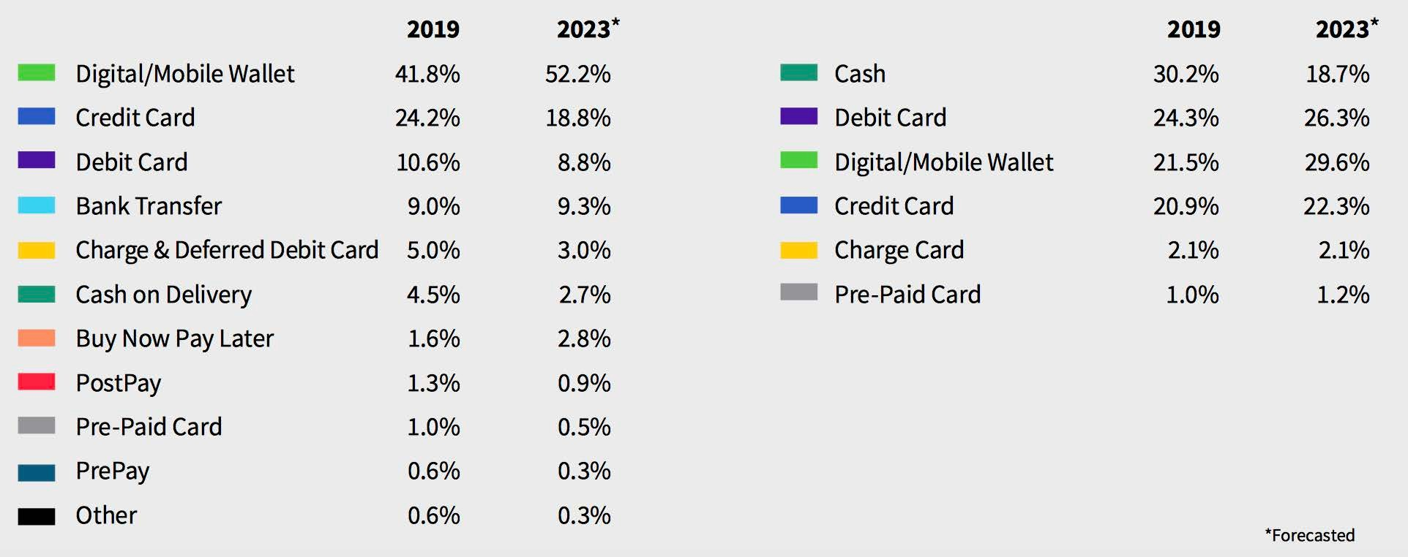
Global Payment Trends
8
© Worldpay. All rights reserved. This content is excluded from our Creative Commons license. For more information, see https://ocw.mit.edu/help/faq-fair-use/
Source: ‘Global Payments Report 2020’, Worldpay (2/27/20)

Slide 38
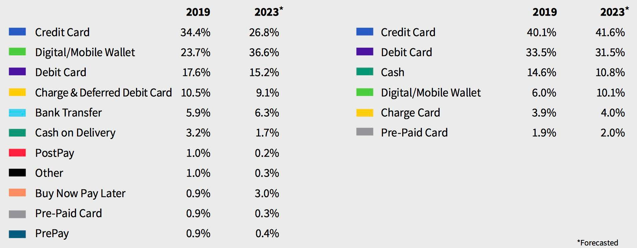
North America Payment Trends
9
Source: ‘Global Payments Report 2020’, Worldpay (2/27/20)
© Worldpay. All rights reserved. This content is excluded from our Creative Commons license. For more information, see https://ocw.mit.edu/help/faq-fair-use/

Slide 39
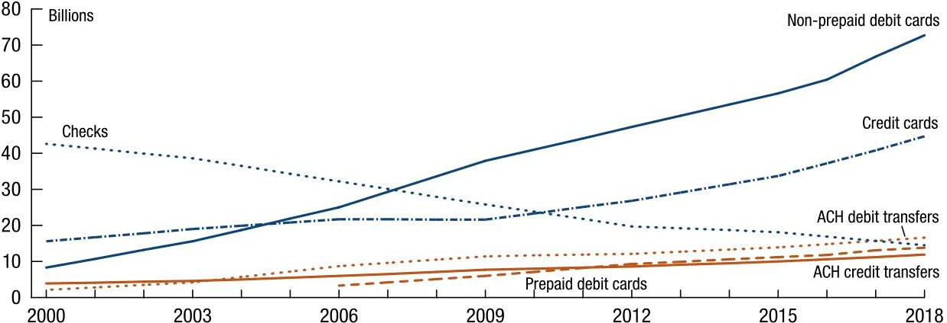
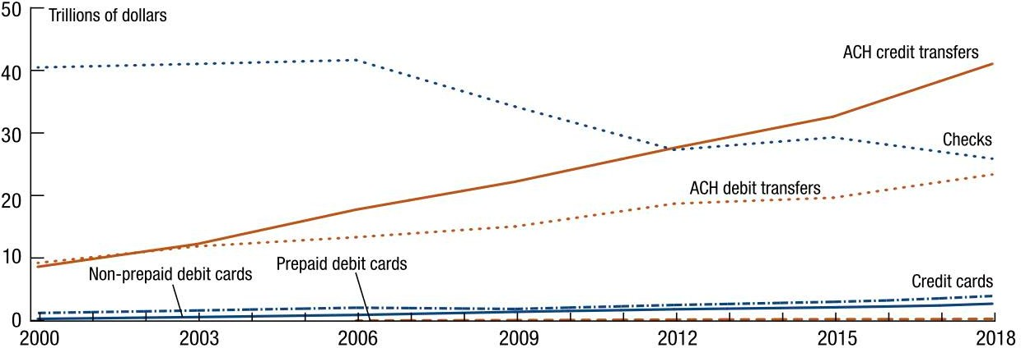
U.S. Payment Trends
10
Courtesy of the Federal Reserve and is in the public domain.
Source: ‘The 2019 Federal Reserve Payments Study’, (December 2019)

Slide 40
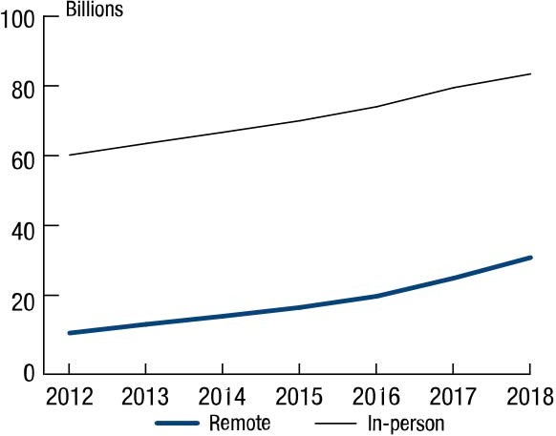
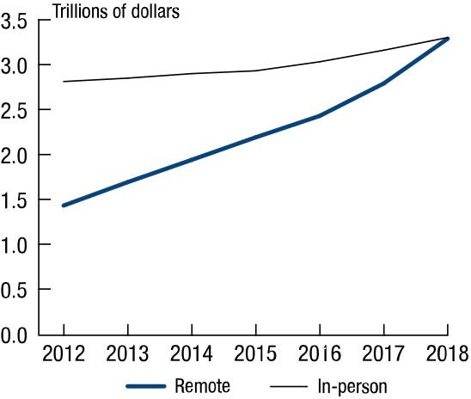
U.S. Card Payment Trends
Courtesy of the Federal Reserve and is in the public domain.
Note: Includes General Purposes Credit & Debit Cards
11
Source: ‘The 2019 Federal Reserve Payments Study’ (December 2019)

Slide 41
Payment System ‘Pain Points’
Chargebacks
Complexity
Costs
Cross Border Payments
Data Privacy
Delayed Settlement
Financial Inclusion
Fraud
Public Policy Compliance
12

Slide 42
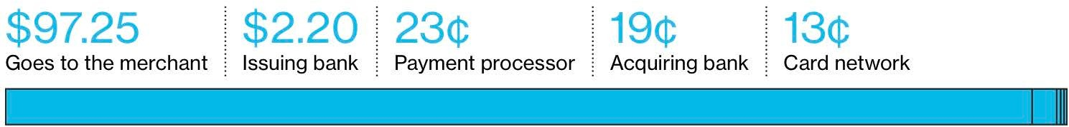
Credit Card Transaction Breakdown
In Typical $100 Purchase
© Bloomberg. All rights reserved. This content is excluded from our Creative Commons license. For more information, see https://ocw.mit.edu/help/faq-fair-use/
13
Source: ‘Why China’s Payment Apps Give U.S. Bankers Nightmares’, Bloomberg (5/23/18)

Slide 43
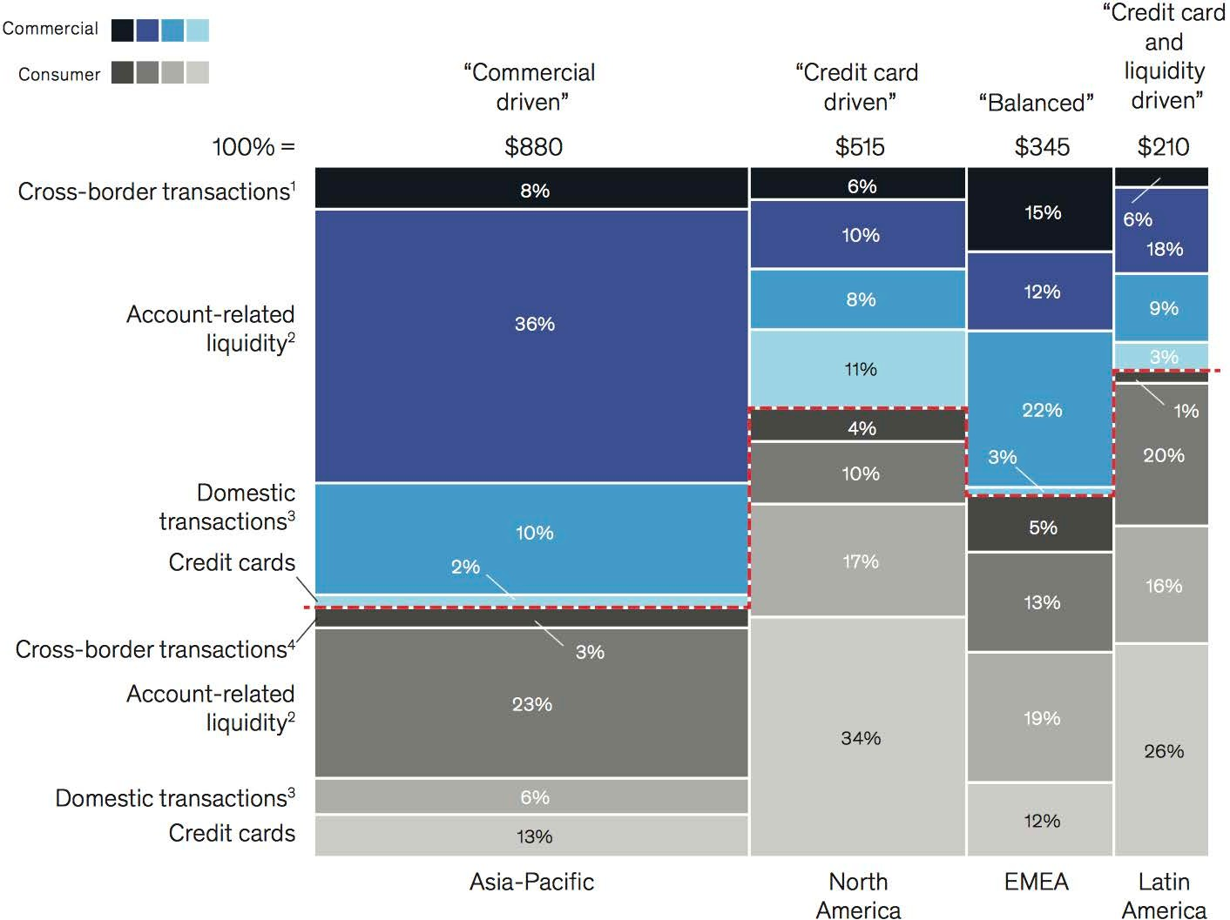
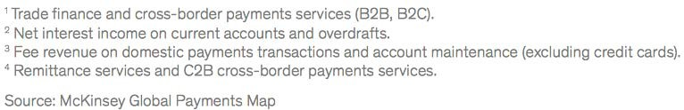
Payments Global Revenues - 2018
© McKinsey & Company. All rights reserved. This content is excluded from our Creative Commons license.
For more information, see https://ocw.mit.edu/help/faq-fair-use/
14
Source: ‘Global Payments Report 2019’, McKinsey (9/1/19), Revenues in Billions

Slide 44
Real Time Gross Settlements (RTGS)
Early Large Value Models: Fed Wire (1970); UK CHAPS (1984); Eurozone TARGET (2002); China CNAPS HVPS
Operational Hours Limited
SWIFT (Society for Worldwide Interbank Financial Telecommunications, founded 1973) Facilitates Interbank Payment Messaging
Real Time Retail ‘Instant’ Payment Systems (24x7x365)
Australia NPP (2018); China IBPS (2010); Eurozone TIPS (2018); India NEFT (2019); Japan Zengin (2018); Mexico SPEI (2015); UK FPS (2011)
U.S. Projects
The Clearing House: Real-Time Payment Network (2017)
Federal Reserve: FedNow Service (announced 2019, expected 2024)
15
Sources: ‘Economic impact of real-time payments’, Deloitte (July 2019) & for India – Reserve Bank of India Notification (12/6/19)

Slide 45






















FinTech – Payments
Big Tech
2003
2007
2007
2011
2013
2014
2014
Startup Unicorns
16
© All rights reserved. This content is excluded from our Creative Commons license. For more information, see https://ocw.mit.edu/help/faq-fair-use/

Slide 46
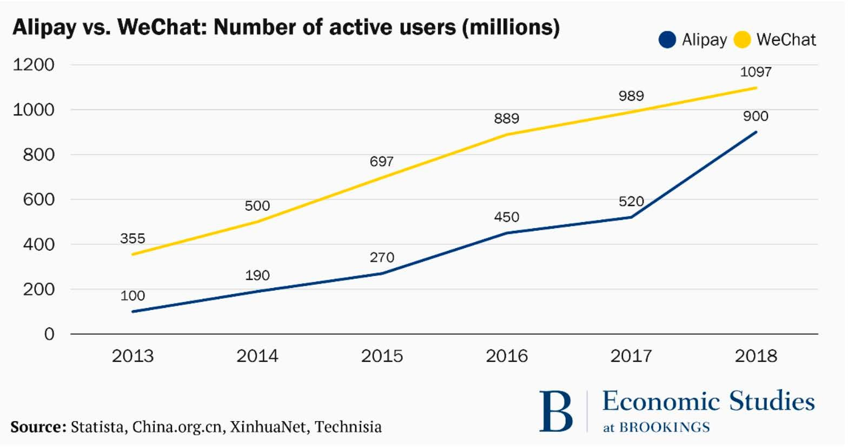
© Brookings Institution. All rights reserved. This content is excluded from our Creative Commons license. For more information, see https://ocw.mit.edu/help/faq-fair-use/
17
Source: ‘Is China’s new payment system the future?’, Aaron Klein, Brookings (6/16/19)

Slide 47
Facebook - Payments
Facebook Credit (2009):
Virtual Currency in 15 currencies,
Terminated 2013
Facebook Messenger payments (2015):
P2P & Charitable Payments offered in US, UK, & France
Terminated P2P in UK & France 2019
WhatsApp Pay (2018)
Pilot in India, to be Rolled Out Conditional on Data Standards
1 Million Accounts Pending further Approvals
Facebook Pay (2019)
Consolidated Ap for Facebook, Messenger, Instagram & WhatsApp
Announced 11/12/19
18

Slide 48
Payment Companies Landscape
Commercial Banks & Bank Owned Payment Networks: 1,000s of Banks (1784 – now), The Clearing House (1853) 24 Large Banks; China UnionPay (2002) 85 founding Banks
Card Companies: Visa (1958) $373B; Mastercard (1966) $268B; AmEx (1850) $76B; Discover (1985) $12B
Payment Services Providers: Fidelity National Information Services (2001) $77B; Fiserv (1984) $67B; Global Payments (2000) $45B
Online, Merchant & Cross Border focused: PayPal (1998) $124B; Square (2009) $26B; Adyen (2006) $26B; FleetCor Technologies (2000) $19B; Wirecard (1999) $15B; Western Union (1851) $8B; StoneCo (2000) $7B; Euronet (1994) $4.7B; ACI (1975)
$3.2B
Private Companies: Stripe (2009) $35B; Paytm (2010) $10B; Klarna (2005) $5.5B; Plaid (2013) $5.3B; Toast 2013) $4.9B; TransferWise (2010) $3.5B; Payoneer (2005) $1+B
Sources: Public Company Valuations from Bloomberg (4/10/20); Private C¹o⁹ mpany Valuations from Forbes & Crunchbase based on latest funding or announced merger

Slide 49
Payment Company Recent Mergers
‘Incumbent’ Payment Service Provider 2019 / 2020 Megadeals:
Fidelity National Information Services - Worldpay: $34B (+ $9B Debt)
Fiserv - First Data: $22B (+ $17B Debt)
Global Payments – Total Systems Services: $21.5B
Worldline – Ingenico: $8.6B
API / Data Aggregator 2020 Deals:
Visa – Plaid: $5.3B
Sofi – Galileo: $1.2B
20
Sources: Individual public announcements by Acquiring Companies

Slide 50
Stablecoins & Messaging App Crypto Projects
Retail Stable Value Tokens:
Tether, USD Coin, Paxos Standard, TrueUSD, DAI, Binance USD
Wholesale Stable Value Token Projects:*
Fnality (aka Utility Settlement Coin), JPM Coin (JP Morgan),
Wells Fargo (Wells Fargo Digital Cash), IBM Blockchain World
Wire
Messaging App Token Projects:
Facebook Libra, Telegram GRAM, LINE (Japan) Link
* Mizuho Financial Group’s J-Coin digital money offering has similarities but does not use token technology
21

Slide 51
Payment Cryptocurrency Tokens
Bitcoin (2009) - $128B market value
XRP (2013) - $8.5B - for Ripple’s xRapid cross-border application
Bitcoin Cash (2017) - $4.4B - hard fork off Bitcoin, 32MB block size
Bitcoin SV (2018) - $3.5B – hard fork off Bitcoin Cash, 128MB block size
Litecoin (2013) - $2.8B – Bitcoin fork, 2.5 minute block times, ASIC resistance
Stellar (2014) - $1B - Stellar Consensus Protocol with ledger chains
IOTA (2017) - $455M – designed for micropayments on IoT
Privacy Coins - $2.3B total - Monero (2014), Dash (2014), Zcash (2016), etc.
22
Source: Market Values from CoinMarketCap.com (4.12.20)

Slide 52
Tokenization Goals
Broadened Access, Enhanced Liquidity & Efficiency through:
Extending Settlement to 24 hours by 7 days per week
Real time Instant Settlement with Finality of Transfer
Borderless Permissionless Censorship Resistant Exchange
Peer to Peer and possible related Disintermediation
Broader Investor Base
Smart Contracts and Automation
Fractionalization
For:
Payments
Payments vs. Payments (PvP)
Payment +/or Security side of Delivery vs. Payment (DvP)
Atomic Swaps of Value
23

Slide 53
Facebook Libra Design Decisions
Promote Libra as Global Digital Currency & Payment Solution
“The goal of the Libra Blockchain is to serve as a solid foundation for financial services, including a new global currency, which could meet the daily financial needs of billions of people.”
Create Multicurrency Libra Reserve to back Libra
Government Securities & Bank Deposits - US, Euro, UK, & Japan
Pay No interest on Libra
Use ETF mechanisms for Libra Issuance and Redemptions
Issue Libra Investment Token (LIT) earning Interest on Libra Reserve & to Promote Customer Adoption
24

Slide 54

Facebook Libra Design Decisions
Use Libra Blockchain for a permissioned distributed ledger
Develop Move language so apps can run on top of network
Set up Libra Association as Swiss non-profit to Manage Libra Reserve and Libra Network
Recruit 100 Large Organizations as Libra Association members
Set up subsidiary Calibra offering services & custody tokens
Offer digital custodial Calibra Wallet for Libra tokens
25

Slide 55
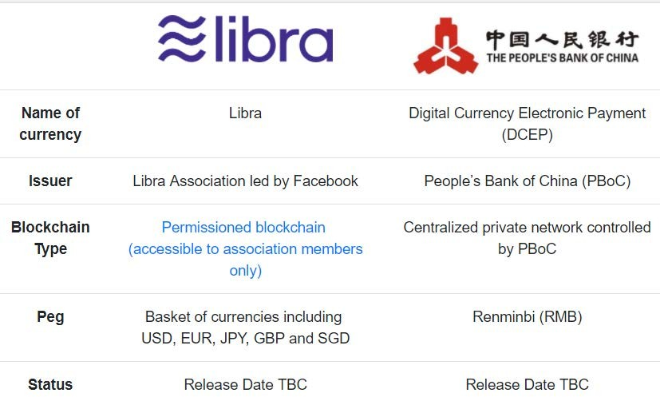
Libra vs. China DCEP
26
Source: ‘The Digital Currency Race’, Tabul8tor (12/4/19)
© Tabul8tor. All rights reserved. This content is excluded from our Creative Commons license. For more information, see https://ocw.mit.edu/help/faq-fair-use/

Slide 56
Readings
'Apple Card: 12 Fintech Companies Driving Credit Card Innovation' Crunchbase
'Need a loan? There's a tech company for that' Jason Abbruzzese, NBC
'Get to Know Your Marketplace Lenders' American Banker
'Alternative Data Across the Loan Life Cycle: How FinTech and Other Lenders Use It and Why' Experian
3

Slide 57
Study Questions
How have Big Tech firms positioned themselves to offer credit and lending products to consumers and businesses?
What is marketplace or peer-to-peer lending? What is point of sale lending? How might they change the provision of consumer credit and its competitive landscape?
How is so-called ‘Alternative Data’ and machine learning changing the world of credit ratings and underwriting?
4

Slide 58
Libra vs. China DCEP
© Tabul8tor. All rights reserved. This content is excluded from our Creative Commons license. For more information, see https://ocw.mit.edu/help/faq-fair-use/
5
Source: ‘The Digital Currency Race’, Tabul8tor (12/4/19)

Slide 59
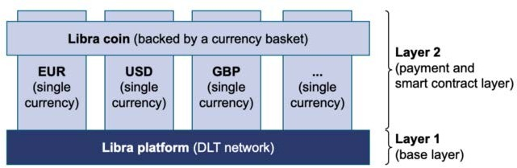
Libra 2.0
Source: ‘Understanding Libra 2.0: A compliant global platform for the digital programmable⁶ EUR, USD, GBP & Co.’, Philipp Sandner (4/17/20)
Courtesy of Phillipp Sandner. Used with permission.

Slide 60
Credit Sectors
Household:
Mortgages, Auto, Credit Card, Personal Loans, Student Loans
Super Prime, Prime, Subprime
Secured, Unsecured, Term, Revolving
Purchase, Debt Consolidation, Refinance, Point of Sale
Corporate:
Small Business, SBA Loans, SME / Mid Market, Large Enterprise
Bonds, Loans
Investment Grade, High Yield, Leveraged Loans
Unsecured - Cash Advance, Purchase Credit, Working Capital
Secured - Floor Plans, Invoice Factoring, Inventory Finance
7

Slide 61
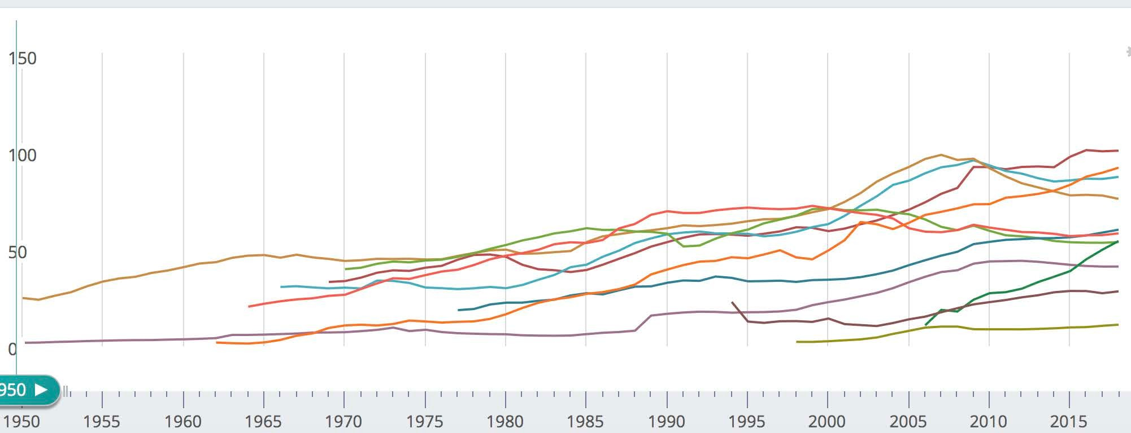











Household Debt as Percent of GDP
8
© IMF. All rights reserved. This content is excluded from our Creative Commons license. For more information, see https://ocw.mit.edu/help/faq-fair-use/
Source: IMF DataMapper

Slide 62
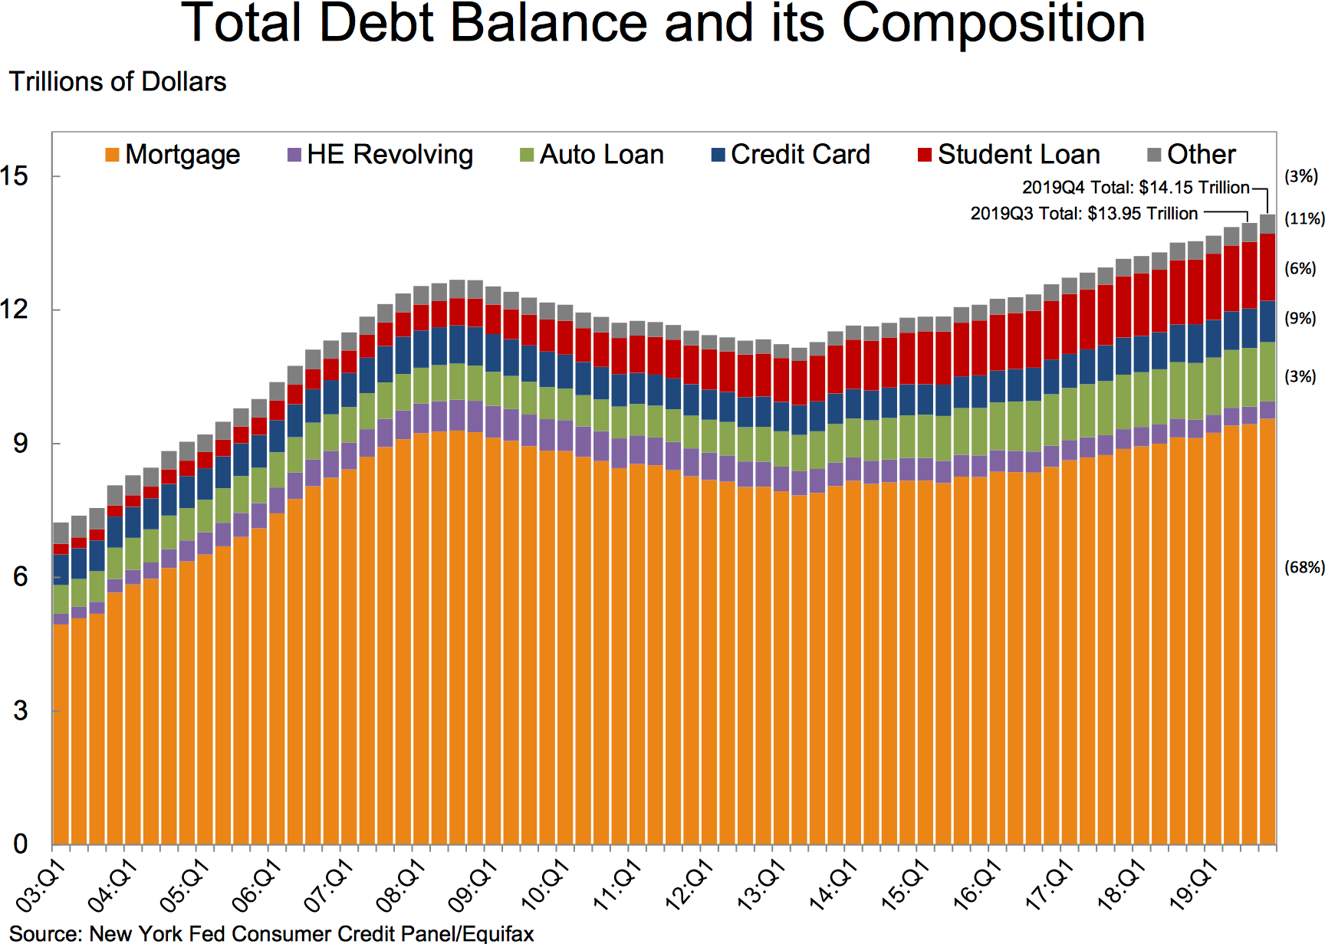
Courtesy of the Federal Reserve Bank of New York. Used with permission.
9

Slide 63
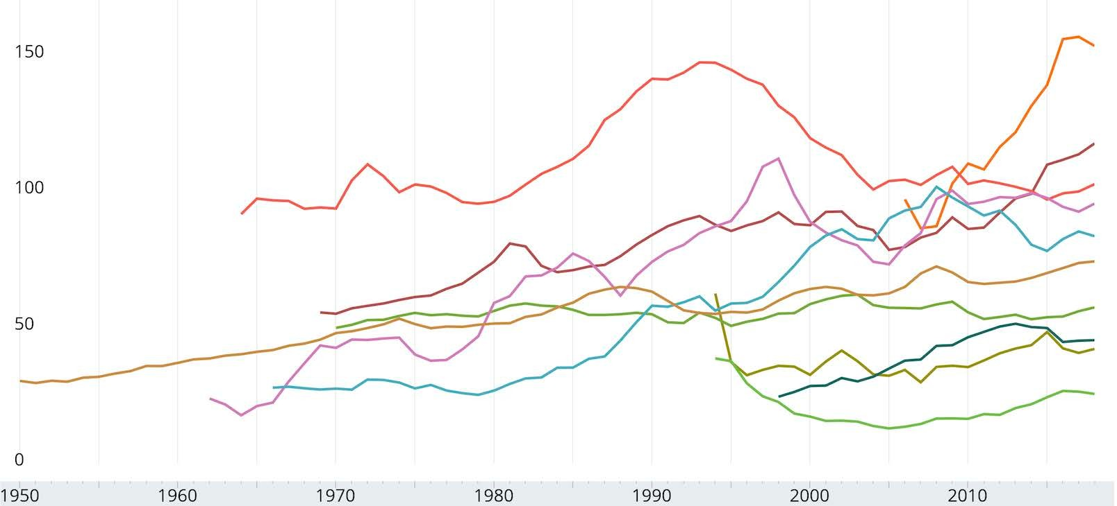





Non Financial Corporate Debt as % of GDP
10
© IMF. All rights reserved. This content is excluded from our Creative Commons license. For more information, see https://ocw.mit.edu/help/faq-fair-use/
Source: IMF DataMapper

Slide 64
Credit & Lending: Market Design
Data
Alternative Data, Credit Scoring, Cross Selling, Marketing & Underwriting
Funding
Balance Sheet, Securitization, or Issuer Bank Partner
Marketing Channels
User Experience & User Interface
Risks
Credit / Default, Market (Basis, Rate, Spread, Volatility), & Prepayment
Funding, Liquidity, Model, Operational, & Reputational / Compliance
Roles
Brokerage / Origination, Underwriting, Credit Enhancing, Securitizing, Credit Rating, Appraising, Servicing, Collecting / Foreclosing, & Funding
11

Slide 65
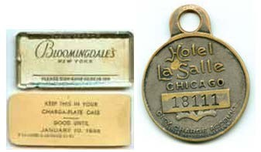

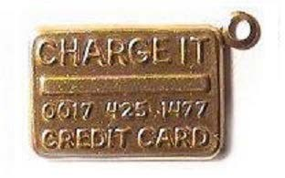
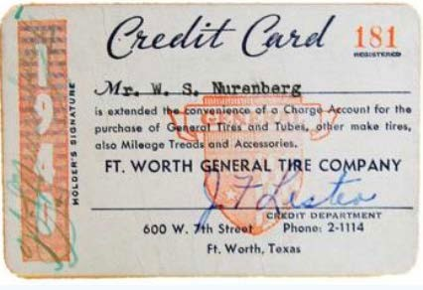
Credit Cards & Charge Coins
Charge Coins & Charga-Plates
Late 1880s – 1960s
First Bank Card Charge-It
Flatbush National Bank
Brooklyn, 1946
Term ‘Credit Card’ Edward Bellamy’s Science Fiction ‘Looking Backward’ 1887
Book cover in the public domain.
© Bloomingdales, First Bank, Ft. Worth General Tire Company, and Hotel La Salle.
All rights reserved. This content is excluded from our Creative Commons license. Late 1920s – 2000s For more information, see https://ocw.mit.edu/help/faq-fair-use/
12
Merchant Credit Cards Late 1920s – 2000s

Slide 66
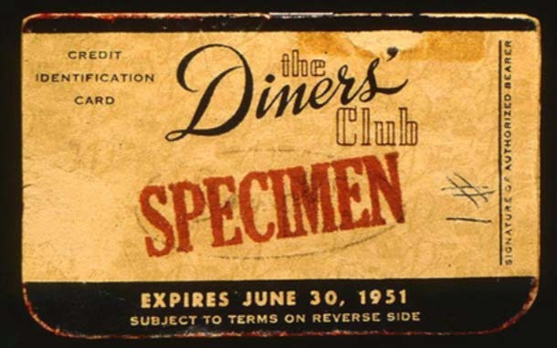
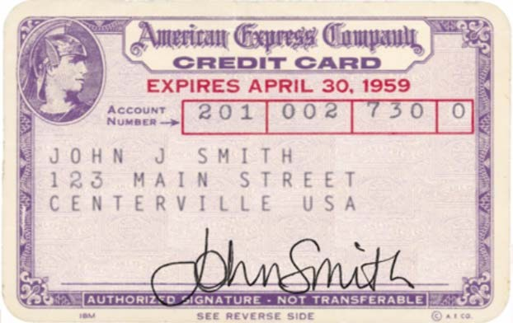
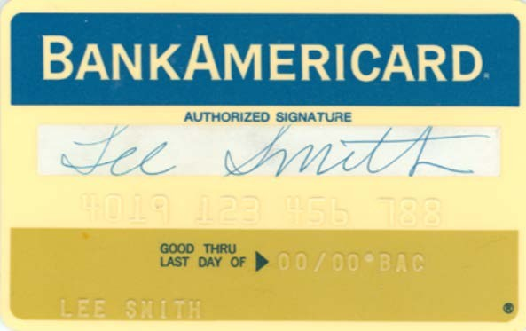
Credit Cards
First General Merchant Card Diners’ Club
1949
American Express First Plastic Card 1959
Bank of America First General Purpose
Credit Card 1966
13
© Diners' Club, American Express, Bank of America. All rights reserved. This content is excluded from our Creative Commons license. For more information, see https://ocw.mit.edu/help/faq-fair-use/

Slide 67

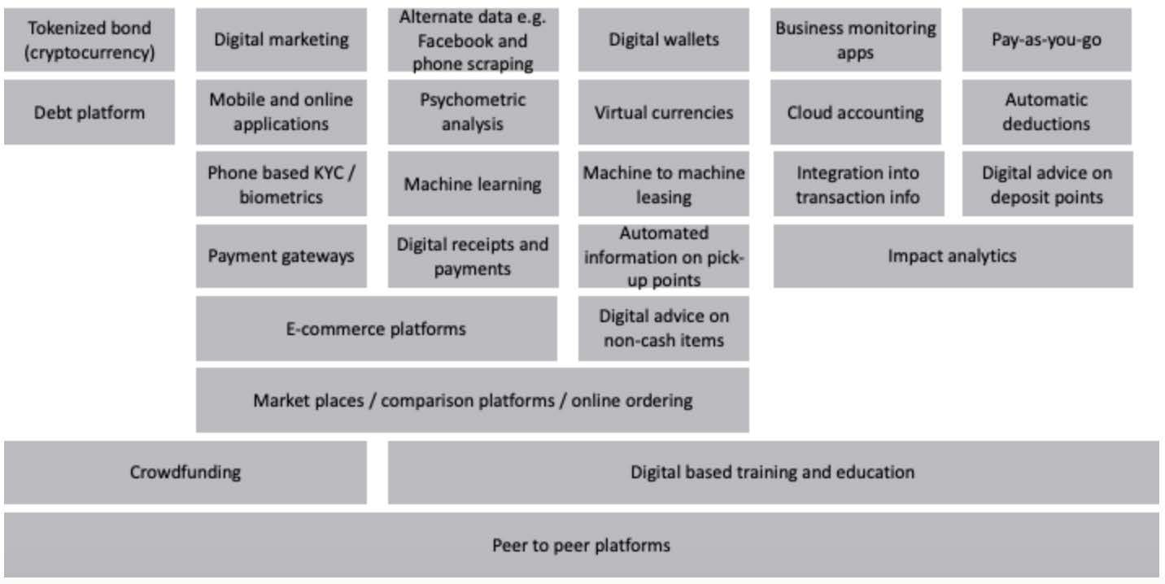
Disruptive Tech Across Credit Value Chain
14
Source: ‘Bridging the credit gap for Micro and Small Enterprises through digitally enabled financing models’, CGAP & Dalberg (January 2019)
Courtesy of CGAP.

Slide 68









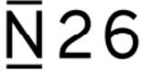





FinTech – Payments & Credit
© Various companies. All rights reserved. This content is excluded from our Creative Commons license. For more information, see https://ocw.mit.edu/help/faq-fair-use/
Big Tech
2003 2007
Payment Unicorns
2007
2011
2013
2014
2014
Credit Unicorns
15

Slide 69
FinTech SME Lending Companies
Alipay
Amazon
BlueVine
Brex
C2FO
DPO
Fundbox
Fundation
Funding Circle
Intuit
Kabbage
Lendio
Payoneer
PayPal
Prosper
Seed
Square
Stripe
Tencent WeBank
Toast
Upserve
16

Slide 70
Largest U.S. Mortgage Lenders – 2018 (out of $1.7 Trillion Originated)
Wells Fargo 258,762 loans $83.4 B
•
Quicken 375,656 loans $81.4 B
JP Morgan Chase
187,642 loans $57.7 B
192,652 loans $55.2 B
Bank of America
United Wholesale Mortgage
LoanDepot
145,579 loans
124,027 loans
$41.6 B
$32.0 B
U.S. Bank
132,253 loans
$29.5 B
Caliber Home Loans
Fairway Independent Mortgage
104,037 loans
105,780 loans
$29.1 B
$24.9 B
Flagstar Bank
73,087 loans $19.6 B
Source: ‘Here are the top 10 mortgage lenders¹⁷of 2018’ Housing Wire (9/6/19)

Slide 71
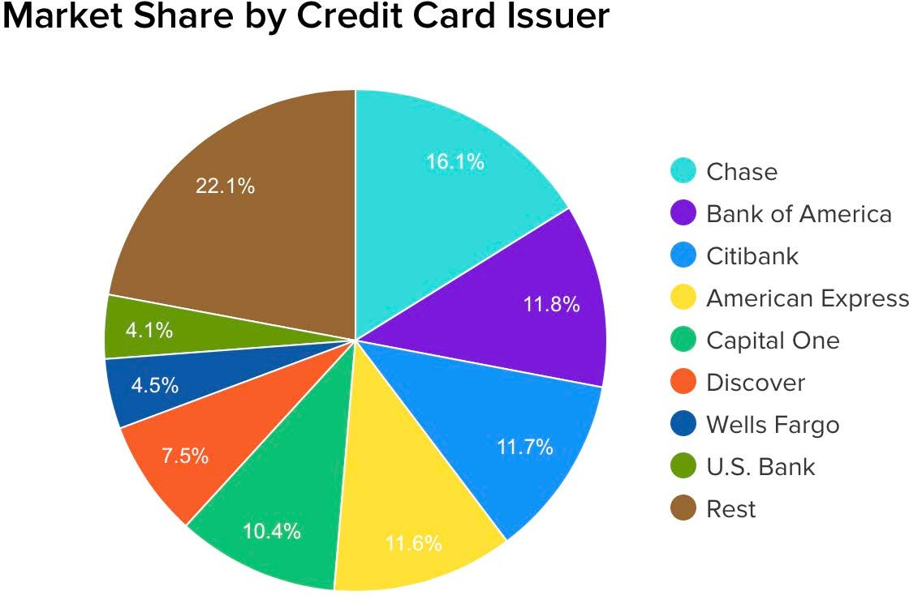
Courtesy of WalletHub. Used with permission.
Source: ‘List of Credit Card Companies, Ca¹r⁸d Networks & Major Cards’, WalletHub (1/13/20)

Slide 72
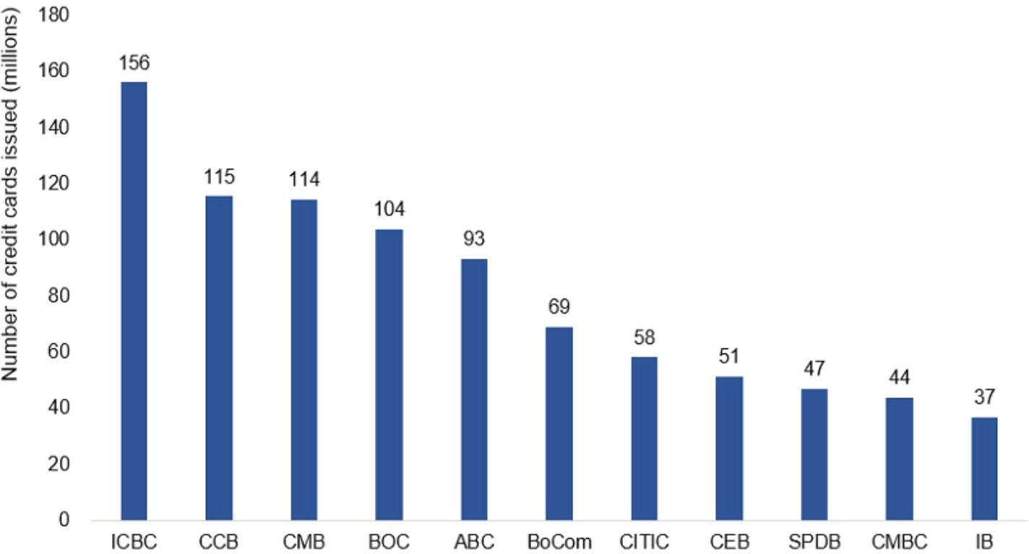
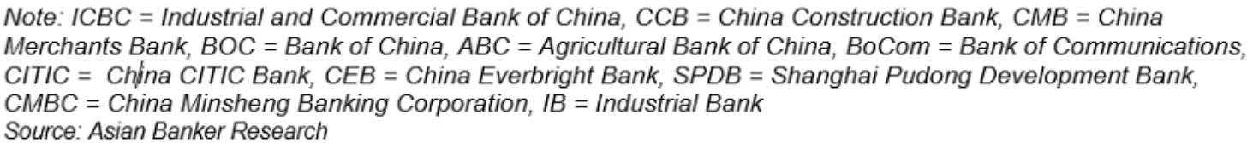
Leading Chinese Credit Card Issuers
Source: ‘Despite rapid digitisation of payments in China, credit card usage will reach new heights by 2¹0⁹ 20’,
The Asian Banker (2/28/19)
© The Asian Banker. All rights reserved. This content is excluded from our Creative Commons license. For more information, see https://ocw.mit.edu/help/faq-fair-use/

Slide 73
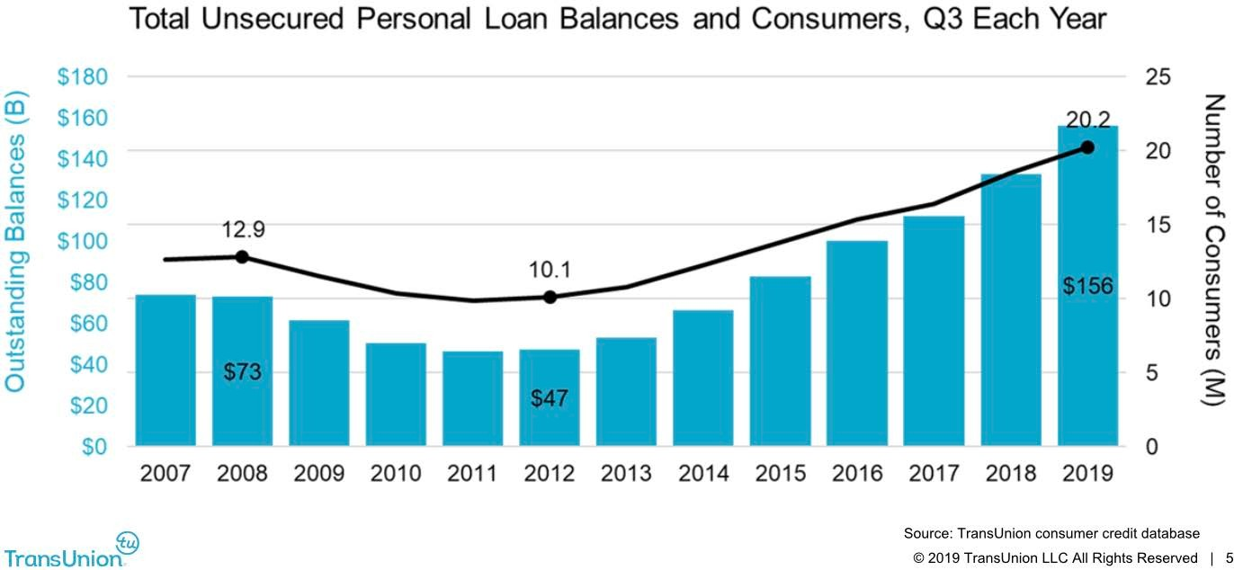
U.S. Unsecured Personal Loans
© TransUnion. All rights reserved. This content is excluded from our Creative Commons license. For more information, see https://ocw.mit.edu/help/faq-fair-use/
20
Source: ‘U.S. Consumers Expected to Maintain Strong Credit Activity in 2020’, TransUnion (12/12/19)

Slide 74
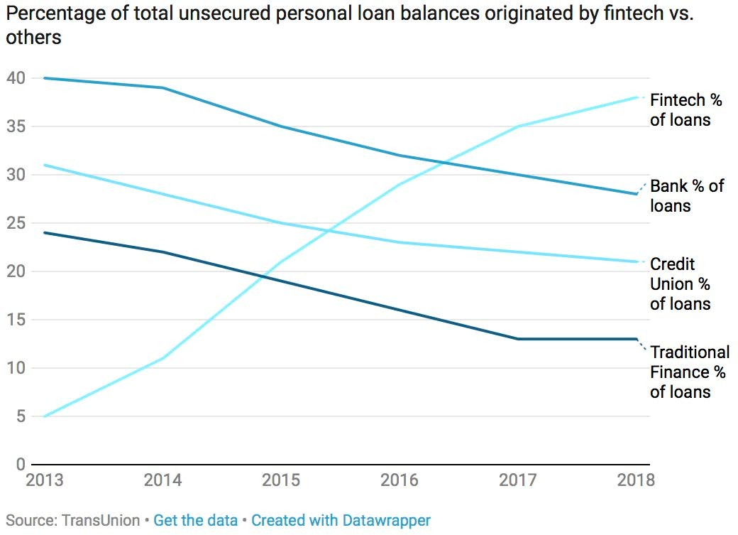
Personal Loan Industry Trends
© CNBC. All rights reserved. This content is excluded from our Creative Commons license. For more information, see https://ocw.mit.edu/help/faq-fair-use/
21
Source: ‘Fintechs help boost US personal loan surge to a record $138 billion’, CNBC (2/21/19)

Slide 75
FinTech Personal Loan Companies
Affirm
Afterpay
Avant
GreenSky
Klarna
Lending Club
Lending Tree
Marcus (by Goldman Sachs)
Monzo
Nubank
Prosper
Revolut
Rocket Loans
SoFi
Square Installments
Upstart
22

Slide 76
Private Student Loan Originators
Ascent
Citizens Bank
College Ave
CommonBond
Credible (comparison shopping)
Discover
Earnest
EDvestinU
INvested
LendKey (partners w/ banks)
MPower
Navient
Prodigy
Sallie Mae
Sofi
SunTrust Bank
Wells Fargo
23

Slide 77
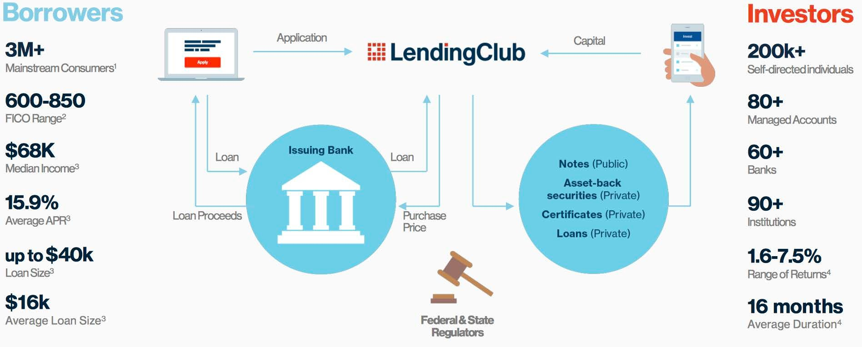
Marketplace Lending - Lending Club
Online Fee Based Platforms Connecting Borrowers with Investors
© Lending Club. All rights reserved. This content is excluded from our Creative Commons license. For more information, see https://ocw.mit.edu/help/faq-fair-use/
24
Source: ‘Investor Roadshow Presentation, Summer 2019’, Lending Club (Summer 2019)

Slide 78
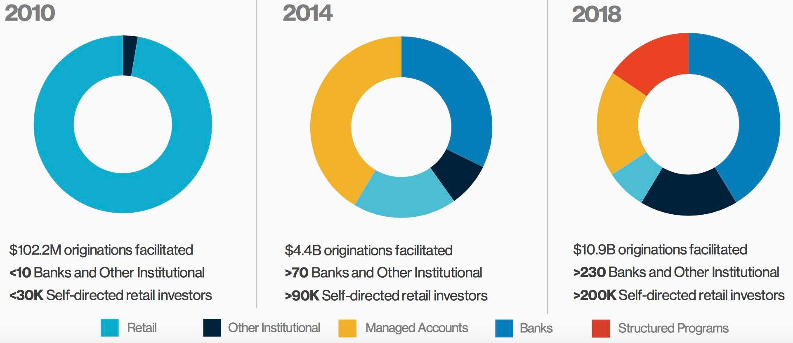
Lending Club
© Lending Club. All rights reserved. This content is excluded from our Creative Commons license. For more information, see https://ocw.mit.edu/help/faq-fair-use/
25
Source: ‘Investor Roadshow Presentation, Summer 2019’, Lending Club (Summer 2019)

Slide 79
China Peer to Peer Lending
343 Companies, down from 2680 in 2016 per 493 B yuan ($70 B) loans outstanding down from 1.3 T yuan ($189 B)
November 2019 Announced new P2P lender regulations
Require 1 B yuan Capital
Only Institutional Funding
Or must exit business
Source: ‘China’s scandal-plagued P2P sector faces ‘continued p²⁶ressure’ in 2020 amid tightening regulation’ South China Morning Post (1/7/20)

Slide 80
Credit Scoring
Fair Isaac Corporation (1989), Vantage (2006)
National Credit Reporting Cos: Equifax, Experian, Trans Union
Innovis, PRBC
Other Screening Credit Reporting Cos:
Check and Bank (6), Employment (15), Gaming (1), Low Income (5), Personal Insurance (4), Medical (2), Retail (1) Supplementary (4), Tenant (7), Utilities (1)
FinTech Startups:
Credit Score Services: Credit Karma, Credit Sesame, Credit.com, Mint, NerdWallet, Quizzle
Data Aggregation: Envestnet |Yodlee, Finicity, Plaid
27
Source for credit reporting companies: ‘List of Consumer Reporting Companies’ CFPB (2020)

Slide 81
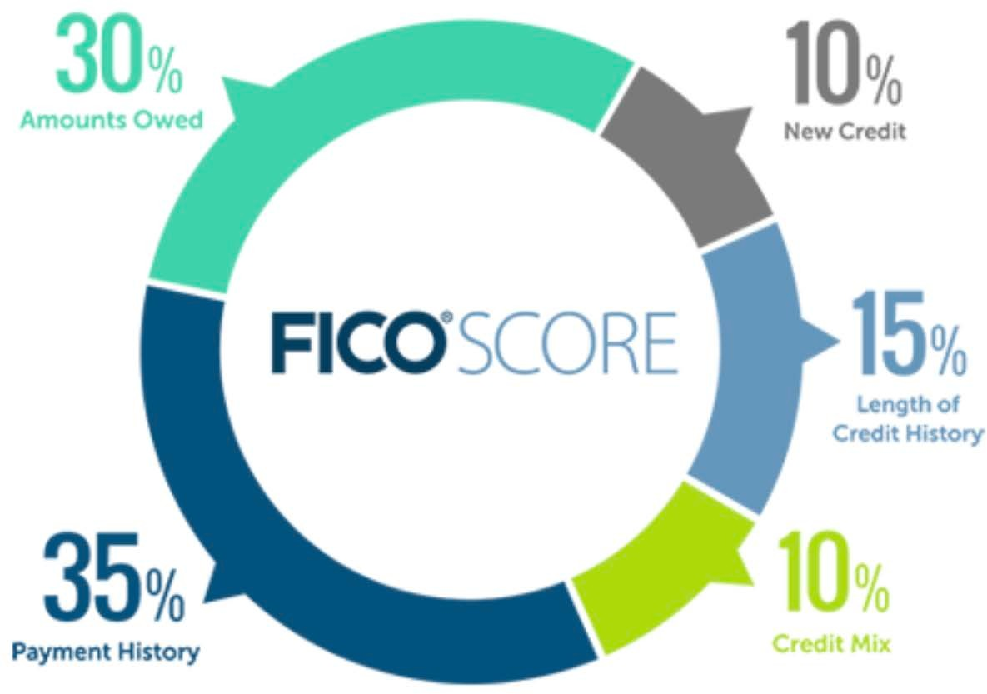
FICO Scores
© FICO. All rights reserved. This content is excluded from our Creative Commons license. For more information, see https://ocw.mit.edu/help/faq-fair-use/
3
Source: ‘What’s in my FICO. Scores?’, myFICO, Fair Isaac Corporation

Slide 82
Alternative Data
Bank, Checking, Employment, Income, Insurance, Tenant, Utilities
Cash Flow Underwriting
Consumption and Purchase Transactional Data
App Usage, Browsing History, Email Receipt, Geolocation, Social Media Data,
Educational Background, Employer, Occupation, Work History
4

Slide 83
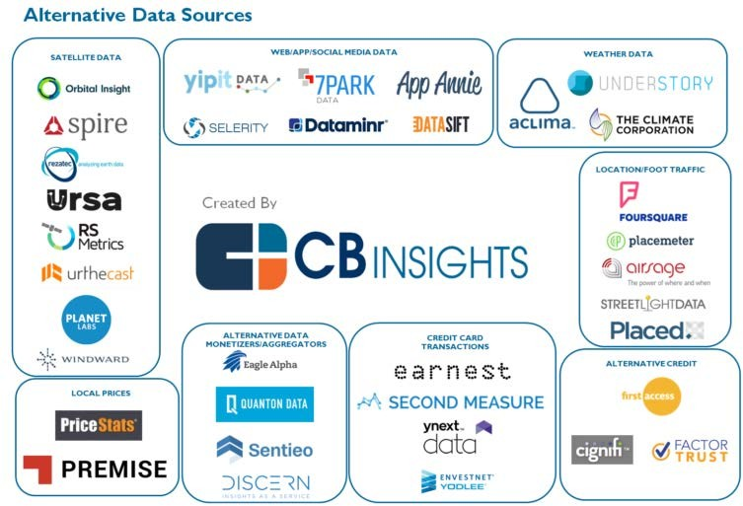
Alternative Data FinTech Landscape
© CB Insights. All rights reserved. This content is excluded from our Creative Commons license. For more information, see https://ocw.mit.edu/help/faq-fair-use/
5
Source: ‘Alternative Data Goes Mainstream in Financial Services’, Datanami (11/21/19)

Slide 84
Readings
'The Challenger Banks That Threaten to Disrupt Financial Institutions' Bill Streeter, The Financial Brand
'Dawn of The Neobank: The Fintechs Trying to Kill the Corner Bank' Forbes
'2020 will be a challenging year for challenger banks' Romain Dillet, TechCrunch
6

Slide 85
Study Questions
What are Challenger or Neobanks?
What gaps or ‘pain points’ in traditional banking might Challenger Banks be addressing? What challenges face these new banks?
How might Challenger or Neobanks affect the banking landscape?
7

Slide 86
Challenges of Traditional Banking
Legacy Branch Networks
Legacy Tech
Product Commoditization
Competitive Landscape
Costs & Fees
User Interface and User Experience
Trust
8

Slide 87
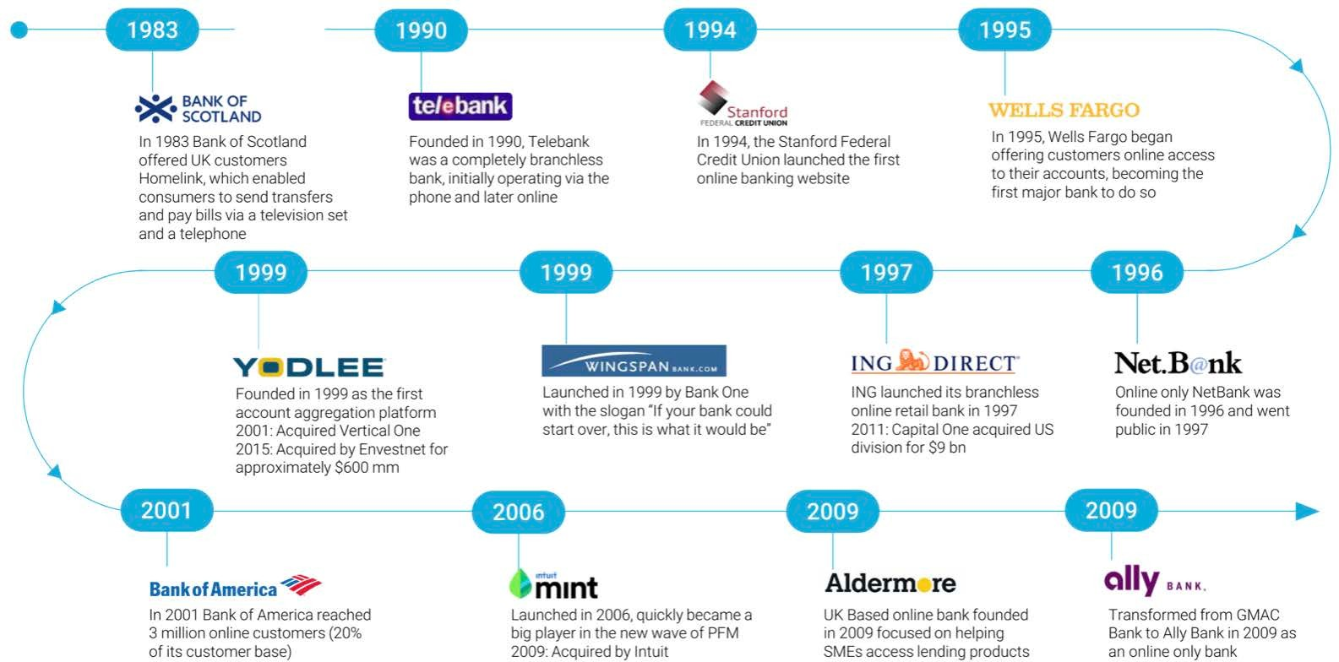
History of Online Banking
9
Source: ‘The Rise of Challenger Banks: Are the Apps Taking Over?’, FT Partners (January 2020)
Courtesy of FT Partners. Used with permission.

Slide 88

© The Financial Brand. All rights reserved. This content is excluded from our Creative Commons license. For more information, see https://ocw.mit.edu/help/faq-fair-use/
Source: ‘The Challenger Banks That Threaten¹⁰ to Disrupt Financial Institutions’, The Financial Brand (2/18/20)

Slide 89
Neo and Challenger Banks
• | Ally Bank (2009) | • | KakaoBank (2016) | • | Revolut (2015)
• | Aspiration (2013) | • | Marcus (2016 by | • | SoFi (2011)
• | Atom Bank (2016) |  | Goldman Sachs) | • | Starling Bank (2014)
• | Axos (1999) | • | MoneyLion (2013) | • | Tandem (2015)
• | BankMobile (2015) | • | Monese (2015) | • | TymeBank (2015)
• | BigPay (2018) | • | Monzo (2015) | • | Uala (2017)
• | Bunq (2012) | • | N26 (2016) | • | Varo (2015)
• | Chime (2013) | • | Nubank (2013) | • | Volt (2017)
• | Dave (2016) | • | OakNorth (2015) | • | WeBank (2015)
11

Slide 90

Neo and Challenger Banks
12
Courtesy of FT Partners. Used with permission.
Source: ‘The Rise of Challenger Banks: Are the Apps Taking Over?’, FT Partners (January 2020)

Slide 91

Product Offerings
13
Courtesy of FT Partners. Used with permission.
Source: ‘The Rise of Challenger Banks: Are the Apps Taking Over?’, FT Partners (January 2020)

Slide 92

PENDINGPERMISSION
Source: ‘Bank Challengers in Europe’, Inteliace Research, SlideShare (January 6, 2020)
© Inteliace Research. All rights reserved. This content is excluded from our Creative Commons license. For more¹⁴information, see https://ocw.mit.edu/help/faq-fair-use/

Slide 93

Customer Accounts
15
Source: ‘The Rise of Challenger Banks: Are the Apps Taking Over?’, FT Partners (January 2020)
Courtesy of FT Partners. Used with permission.

Slide 94

Challenger Bank Valuations
© Forbes. All rights reserved. This content is excluded from our Creative Commons license. For more information, see https://ocw.mit.edu/help/faq-fair-use/
Source: ‘Dawn Of The Neobank: The Fin₁t₆echs Trying To Kill The Corner Bank‘, Forbes (11/4/19)

Slide 95

Funding to Date
17
Source: ‘The Rise of Challenger Banks: Are the Apps Taking Over?’, FT Partners (January 2020)
Courtesy of FT Partners. Used with permission.

Slide 96

Source: ‘The Challenger Banks That Threaten to Disrupt Financial Institutions’, The Financial Brand (2/18/20)
© The Financial Brand. All rights reserved. This content is excluded from our Creative Commons license. For more information, see https://ocw.mit.edu/help/faq-fair-use/
18

Slide 97

Traditional Banks Mobile Offerings
19
Source: ‘The Rise of Challenger Banks: Are the Apps Taking Over?’, FT Partners (January 2020)
Courtesy of FT Partners. Used with permission.

Slide 98
Readings
'Quarterly InsurTech Briefing Q4 2019', CB Insights (Intro & Charts)
'Three insurtech trends to watch in 2020', Harry Menear, FinTech
'Fintech developments in the insurance industry – Executive Summary' Bank of International Settlement
'Why Asia is fertile new ground for the insurtech startup movement', Tech Wire Asia

Slide 99
Study Questions
What opportunities does the current insurance sector landscape and possible ‘pain points’ present for ongoing technological disruption?
How have machine learning, alternative data, and so-called ‘Internet of Things’ devises begun to transform the underwriting, selling, administration & claims processing of insurance?
What are InsurTech trends and applications affecting each part of the insurance sector’s value chain? What are the capital, regulatory, and data challenges confronting startups in this space? To date, why have Big Tech firms been less engaged in insurance than other finance sectors?

Slide 100
Insurance Value Chain
Image by the Federal Insurance Office and is in the public domain.
5
Source: ‘Annual Report on the Insurance Industry’, Federal Insurance Office, U.S. Department of Treasury (September 2019)

Slide 101
Insurance Sector Landscape
Life Insurance: Aegon (1968), AFLAC (1955), China Life (1949), Great West (1891), Legal & General (1836), Manulife (1887), MetLife (1868), New China Life (1996), New York Life (1845), Nippon Life (1889), Prudential (1875), Swiss Life (1857), Taikang Life (1996)
Property & Casualty: Allstate (1931), Chubb (1882), Cincinnati Financial (1950), CNA (1897), Intact Financial (1807), Hartford (1810), Liberty Mutual (1912), Markel (1980), Progressive (1937), State Farm (1922), Travelers (1853)

Slide 102
Insurance Sector Landscape
Health & Managed Care: Anthem (1946), Centene (1984), Cigna (1792), CVS Health / Aetna (1853), Healthcare Services (1936), Humana (1961), UnitedHealth (1977)
Diversified: AIG (1919), Allianz (1890), Axa (1816), Aviva (1696), China Pacific (1991), Generali (1839), Ping An (1988), People’s Insurance Company of China (1949), Zurich (1872)

Slide 103
Insurance Sector Landscape
Reinsurance Companies: Arch Capital (1995), Berkshire Hathaway (1839/1967), Munich Re (1880), Swiss Re (1863)
Brokers: Aon (1918), Brown & Brown (1939), Arthur Gallagher (1927), Marsh & McLennan (1905), Willis Towers Watson (1828)
Benefits Administration: ADP (1949), Paychex (1971)
Claims Administration: Sedgwick (1969)
Software or Services: Duck Creek (2000), Goldwire (2001)

Slide 104

U.S. Insurance Sector Premiums
Image by the Federal Insurance Office and is in the public domain.
9
Source: ‘Annual Report on the Insurance Industry’, Federal Insurance Office, U.S. Department of Treasury (September 2019)

Slide 105

U.S. Life & Health Insurance Premiums
Image by the Federal Insurance Office
and is in the public domain.
105
Source: ‘Annual Report on the Insurance Industry’, Federal Insurance Office, U.S. Department of Treasury (September 2019)

Slide 106

U.S. P & C Insurance Premiums
Image by the Federal Insurance Office
and is in the public domain.
106
Source: ‘Annual Report on the Insurance Industry’, Federal Insurance Office, U.S. Department of Treasury (September 2019)

Slide 107
Insurance Sector Challenges
Agent & Broker Fees
Claims Administration
Distribution Channels
Legacy Tech
Operating Costs & Expense Ratios
Product Development & Speed to Market
Regulatory Landscape
Trust
User Interface and User Experience
12

Slide 108

InsurTech Opportunities
Source: ‘Quarterly InsurTech Briefing Q4 2019', CB Insights ‘ (January 2020)
13
© Willis Towers Watson and CB Insights. All rights reserved. This content is excluded from our Creative Commons license. For more information, see https://ocw.mit.edu/help/faq-fair-use/

Slide 109
InsurTech Opportunities
Sales, Account Management & Claims UI & UX:
Digital, Mobile & Conversational Interface
Underwriting Availability, Pricing & Targeted Products:
Machine Learning & Alternative Data
Claims Processing & Underwriting Data Capture:
Drones, Internet of Thing Sensors, Smartphones Telematics, & Wearables
Genetic Testing – Life, Disability & Long-term Care
14

Slide 110

InsurTech Emerging Technologies
Image by the Federal Insurance Office and is in the public domain.
15
Source: ‘Annual Report on the Insurance Industry’, Federal Insurance Office, U.S. Department of Treasury (September 2019)

Slide 111
InsurTech Challenges
Funding
Capital Requirements if a Carrier
Startup Run Rate Losses
Competitive Landscape
Incumbents
InsurTech Startups
Regulatory Frameworks
Licensing & Compliance
Appropriate use of Data
User Adoption
16

Slide 112

17
Source: ‘2019 FinTech Almanac’, FT Partners (February 2020)
Courtesy of FT Partners. Used with permission.

Slide 113
InsurTech Business Models
Licensed Insurer
Managed General Agent
Technology Service Provider
Data Aggregator

Slide 114
InsurTech Startups
Acko (2017) – Auto, Travel - India
Assurance (2016) – Diversified ‘Financial Wellness’ Direct to Consumer
Bold Penguin (2016) – Commercial Insurance Exchange
CoverHound (2010) – Auto Marketplace Comparison
CoverWallet (2015) – Small Business P & C
Ethos ( 2016) - Life
FINEOS (1993) – Software for Life, Accident & Health
Fri:Day (2017) – Auto – Germany
Goji (2007) – Auto Marketplace using Driving History Data

Slide 115
InsurTech Startups
Hippo (2015) - Home
Insureon (1997) Small Business P & C Marketplace
Insurify (2013) – Auto Marketplace Comparison
Ladder (2015) - Life
Lemonade (2015) – Home, Renters
Metromile (2011) - Auto
Next (2016) – Small Business P & C
Pie Insurance (2017) – Workers Comp

Slide 116
InsurTech Startups
PolicyBazaar (2008) – Life & Health Marketplace Comparison - India
PolicyGenius (2014) - Marketplace Comparison
Prima Assicurazioni (2015) – Auto - Italy
Root (2015) - Auto
Singlife (2014) – Life - Singapore
Snapsheet (2011) – Claims Management
Tractable (2014) – Auto Claims Management
WeFox / One (2015) – Marketplace / P & C Carrier - Germany
ZhongAn (2013) – Online P & C - China

Slide 117

22
Source: ‘2019 FinTech Almanac’, FT Partners (February 2020)
Courtesy of FT Partners. Used with permission.

Slide 118
Health InsurTech Startups
American Well (2006) - Telehealth
BIMA (2010) – Emerging Markets
Bright Health (2015) – Medicare Advantage
CareCloud (2009) – Patient Billing & Claims Management
Clover (2014) – Patient Analytics & Preventive Care driven Insurance
Collective Health (2013) – Self employed & Small Business Platform

Slide 119
Health InsurTech Startups
GoHealth (2001) - Marketplace Comparison
Gusto (2011) – Benefits & Payroll Administrations
HealthEquity (2002) – Benefits & Health Savings Account Administrator
Oscar Health (2012) – Individual & Small Business Coverage
Shuidi (2016) – Crowdfunding of Medical Bills - China
Zenefits (2013) - Benefits Administrations

Slide 120
Data Related InsurTech Startups
Cambridge Mobile Telematics (2010) – Road & Driver Safety
FitSense (2015) – Data Analytics for Health & Life
Habit Analytics (2018) – Behavioral Patterns from Smartphone & IoT
HyperScience (2014) – Automated Data Entry
Open Data Nation (2015) – Public Records Data Aggregator
RiskGenius (2015) – Policy Automation Platform
Shift Technology (2013) – Fraud Detection
StrongArm Tech (2011) – Sensor Data for Safety & Injury Protection
The Floow (2012) – Auto Telematics
TrueMotion (2012) – Smartphone Sensor Data to Score Drivers

